Slide 1
FROM DATA DINOSAURS TO THE DAWN OF BIG DATA
Steve Doig
Arizona State University

Slide 2
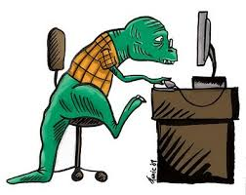
Notes:
I’m a dinosaur

Slide 3
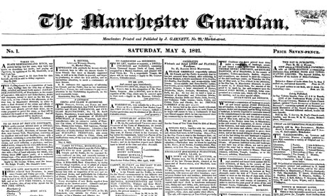
Notes:
May 5, 1821: Table of school showing number of pupils and average annual spending.

Slide 4
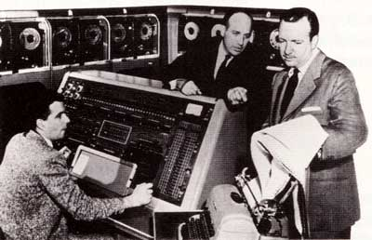
Notes:
Cronkite and UNIVAC in 1952

Slide 5
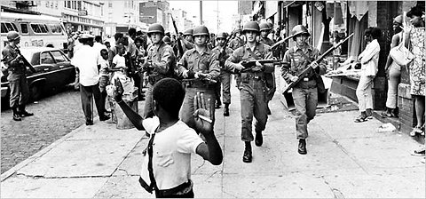
Notes:
Phil Meyer and race riots in Miami and Detroit in 1968

Slide 6
Notes:
I entered Dartmouth College in 1966

Slide 7
Notes:
Learned BASIC in freshman calculus

Slide 8
Notes:
I never took any more math or stats – big mistake

Slide 9
Notes:
Instead, I drank beer and fell in love

Slide 10
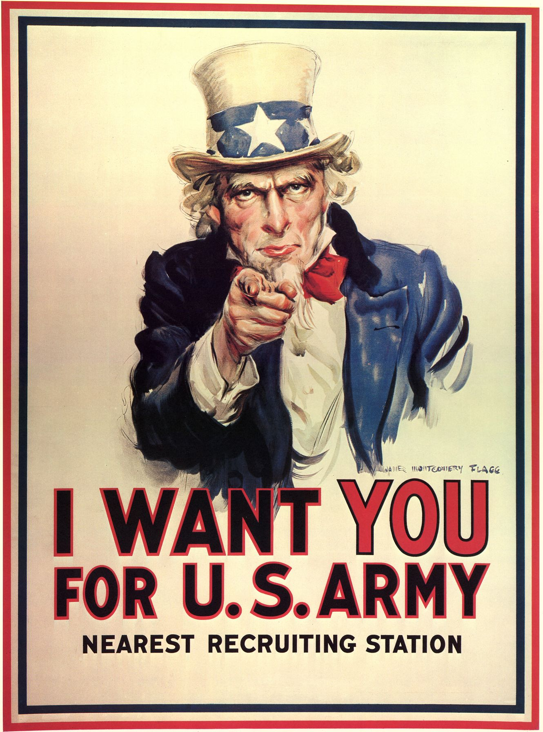
Notes:
Tossed from Dartmouth, I joined the Army in 1969

Slide 11
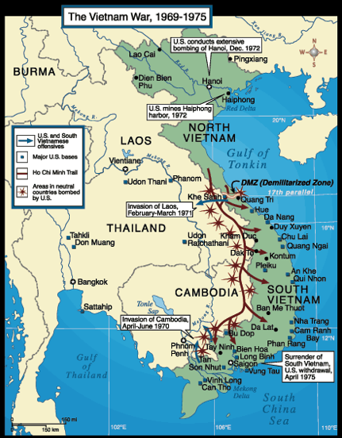
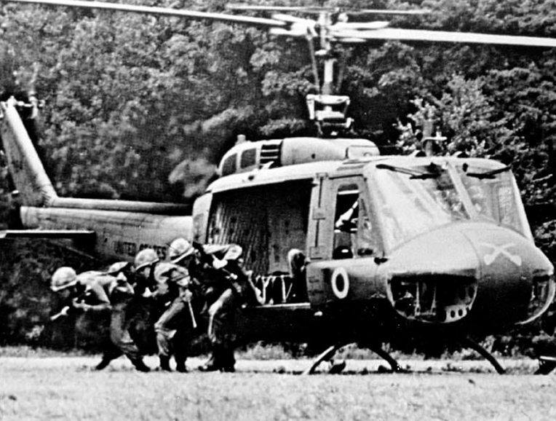
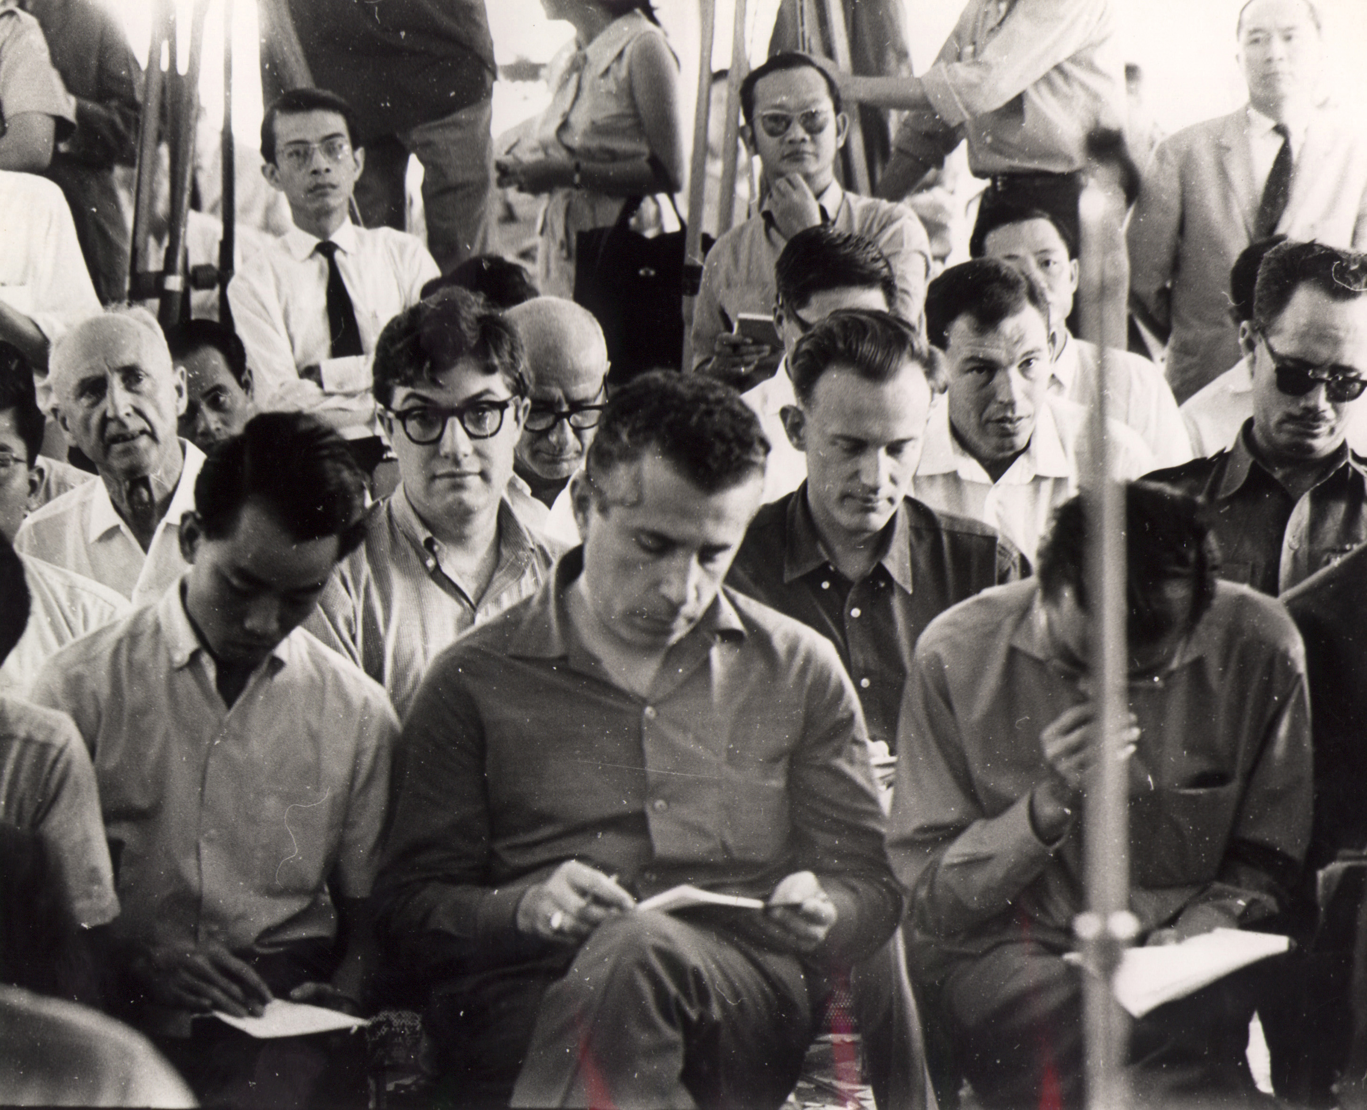
Notes:
Working with the Saigon press corps made me think of journalism as a career

Slide 12
Notes:
Finished at Dartmouth, worked in Daytona Beach, then the Herald

Slide 13
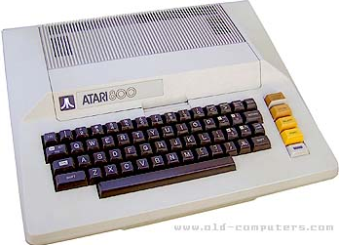
Notes:
Bought Atari 800 in 1981…8k RAM…cost about $2,000 with CRT and drives (equiv of $5,200 today)

Slide 14
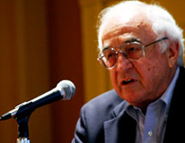
Notes:
Discovered “Precision Journalism” written by Phil Meyer in 1972

Slide 15
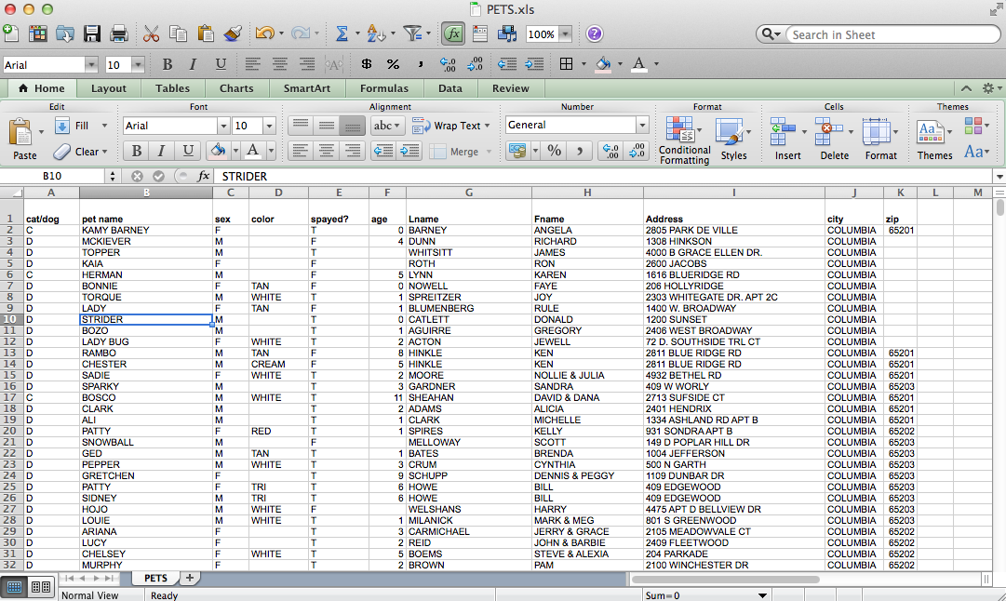
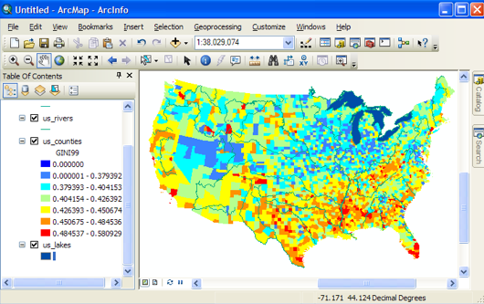
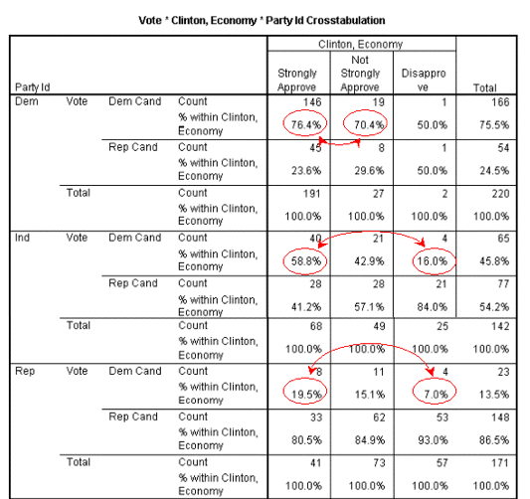
Notes:
Learned to use spreadsheets and mapping and other data programs

Slide 16
Notes:
Car can help you find the best anecdotes….

Slide 17
Notes:
Segregation study 1970-1980...took nine years to publish
When 1990 Census was coming, I said we could be faster

Slide 18
Notes:
Called demographer William Frey for reaction:
“My god...I had no idea newspapers could do this kind of thing.”
Beat USA Today and Phil Meyer

Slide 19
Notes:
Murder by ZIP CODE STORY

Slide 20
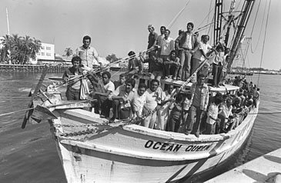
Notes:
MARIEL BOATLIFT

Slide 21
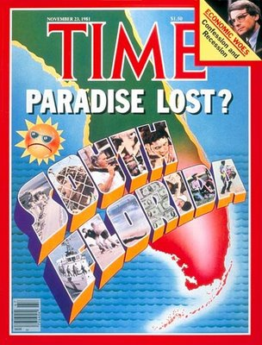

Slide 22
Notes:
DOG LICENSES MOST FAMOUS STORY

Slide 23
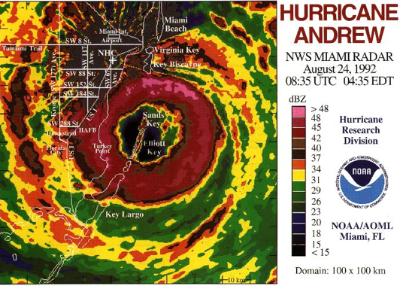
Notes:
Pasteur: Chance favors the prepared mind

Slide 24
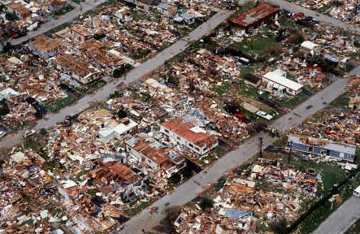
Notes:
>80k homes damaged or destroyed

Slide 25
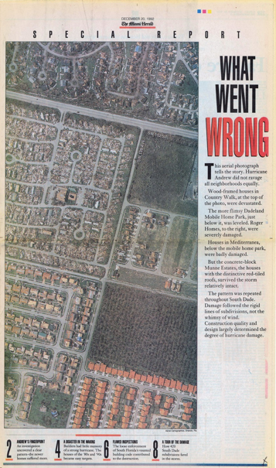
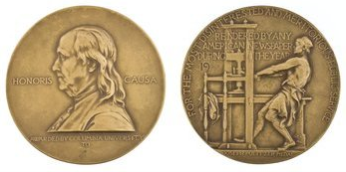
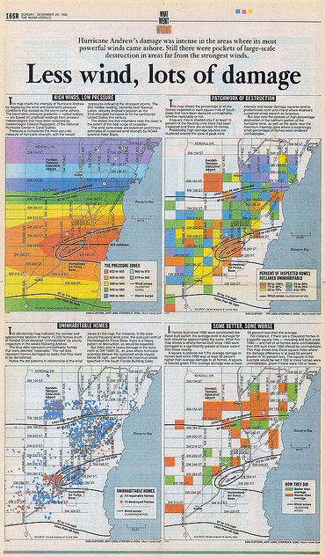
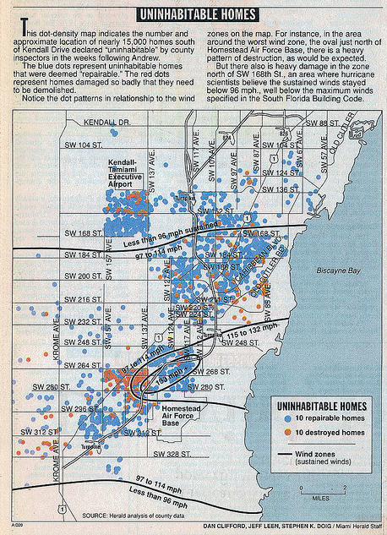
Notes:
“WHAT WENT WRONG” got the Pulitzer for Public Service

Slide 26
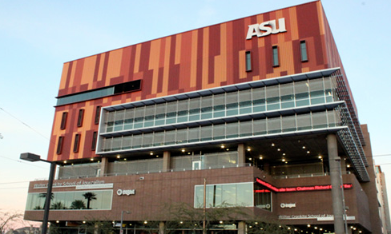
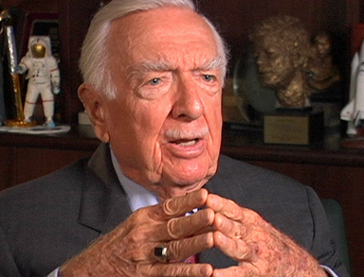

Slide 27
Notes:
Social science done on deadline

Slide 28
Notes:
Finding patterns in the data

Slide 29
Notes:
Putting the pieces together

Slide 30
Notes:
Finding the smoking gun

Slide 31
Notes:
Public records have made this all possible

Slide 32
Notes:
Many software tools available to us now…

Slide 33
Notes:
Now working with hundreds of millions of records.
HOSPITAL BILLING FRAUD >50 MILLION RECORDS

Slide 34
PREGUNTAS?
Notes:
Questions??

